Slide 1



Hopitality Domain
View in Power BI
Last data refresh:
8/19/2023 10:35:32 AM UTC
Downloaded at:
8/19/2023 1:57:33 PM UTC

Slide 2
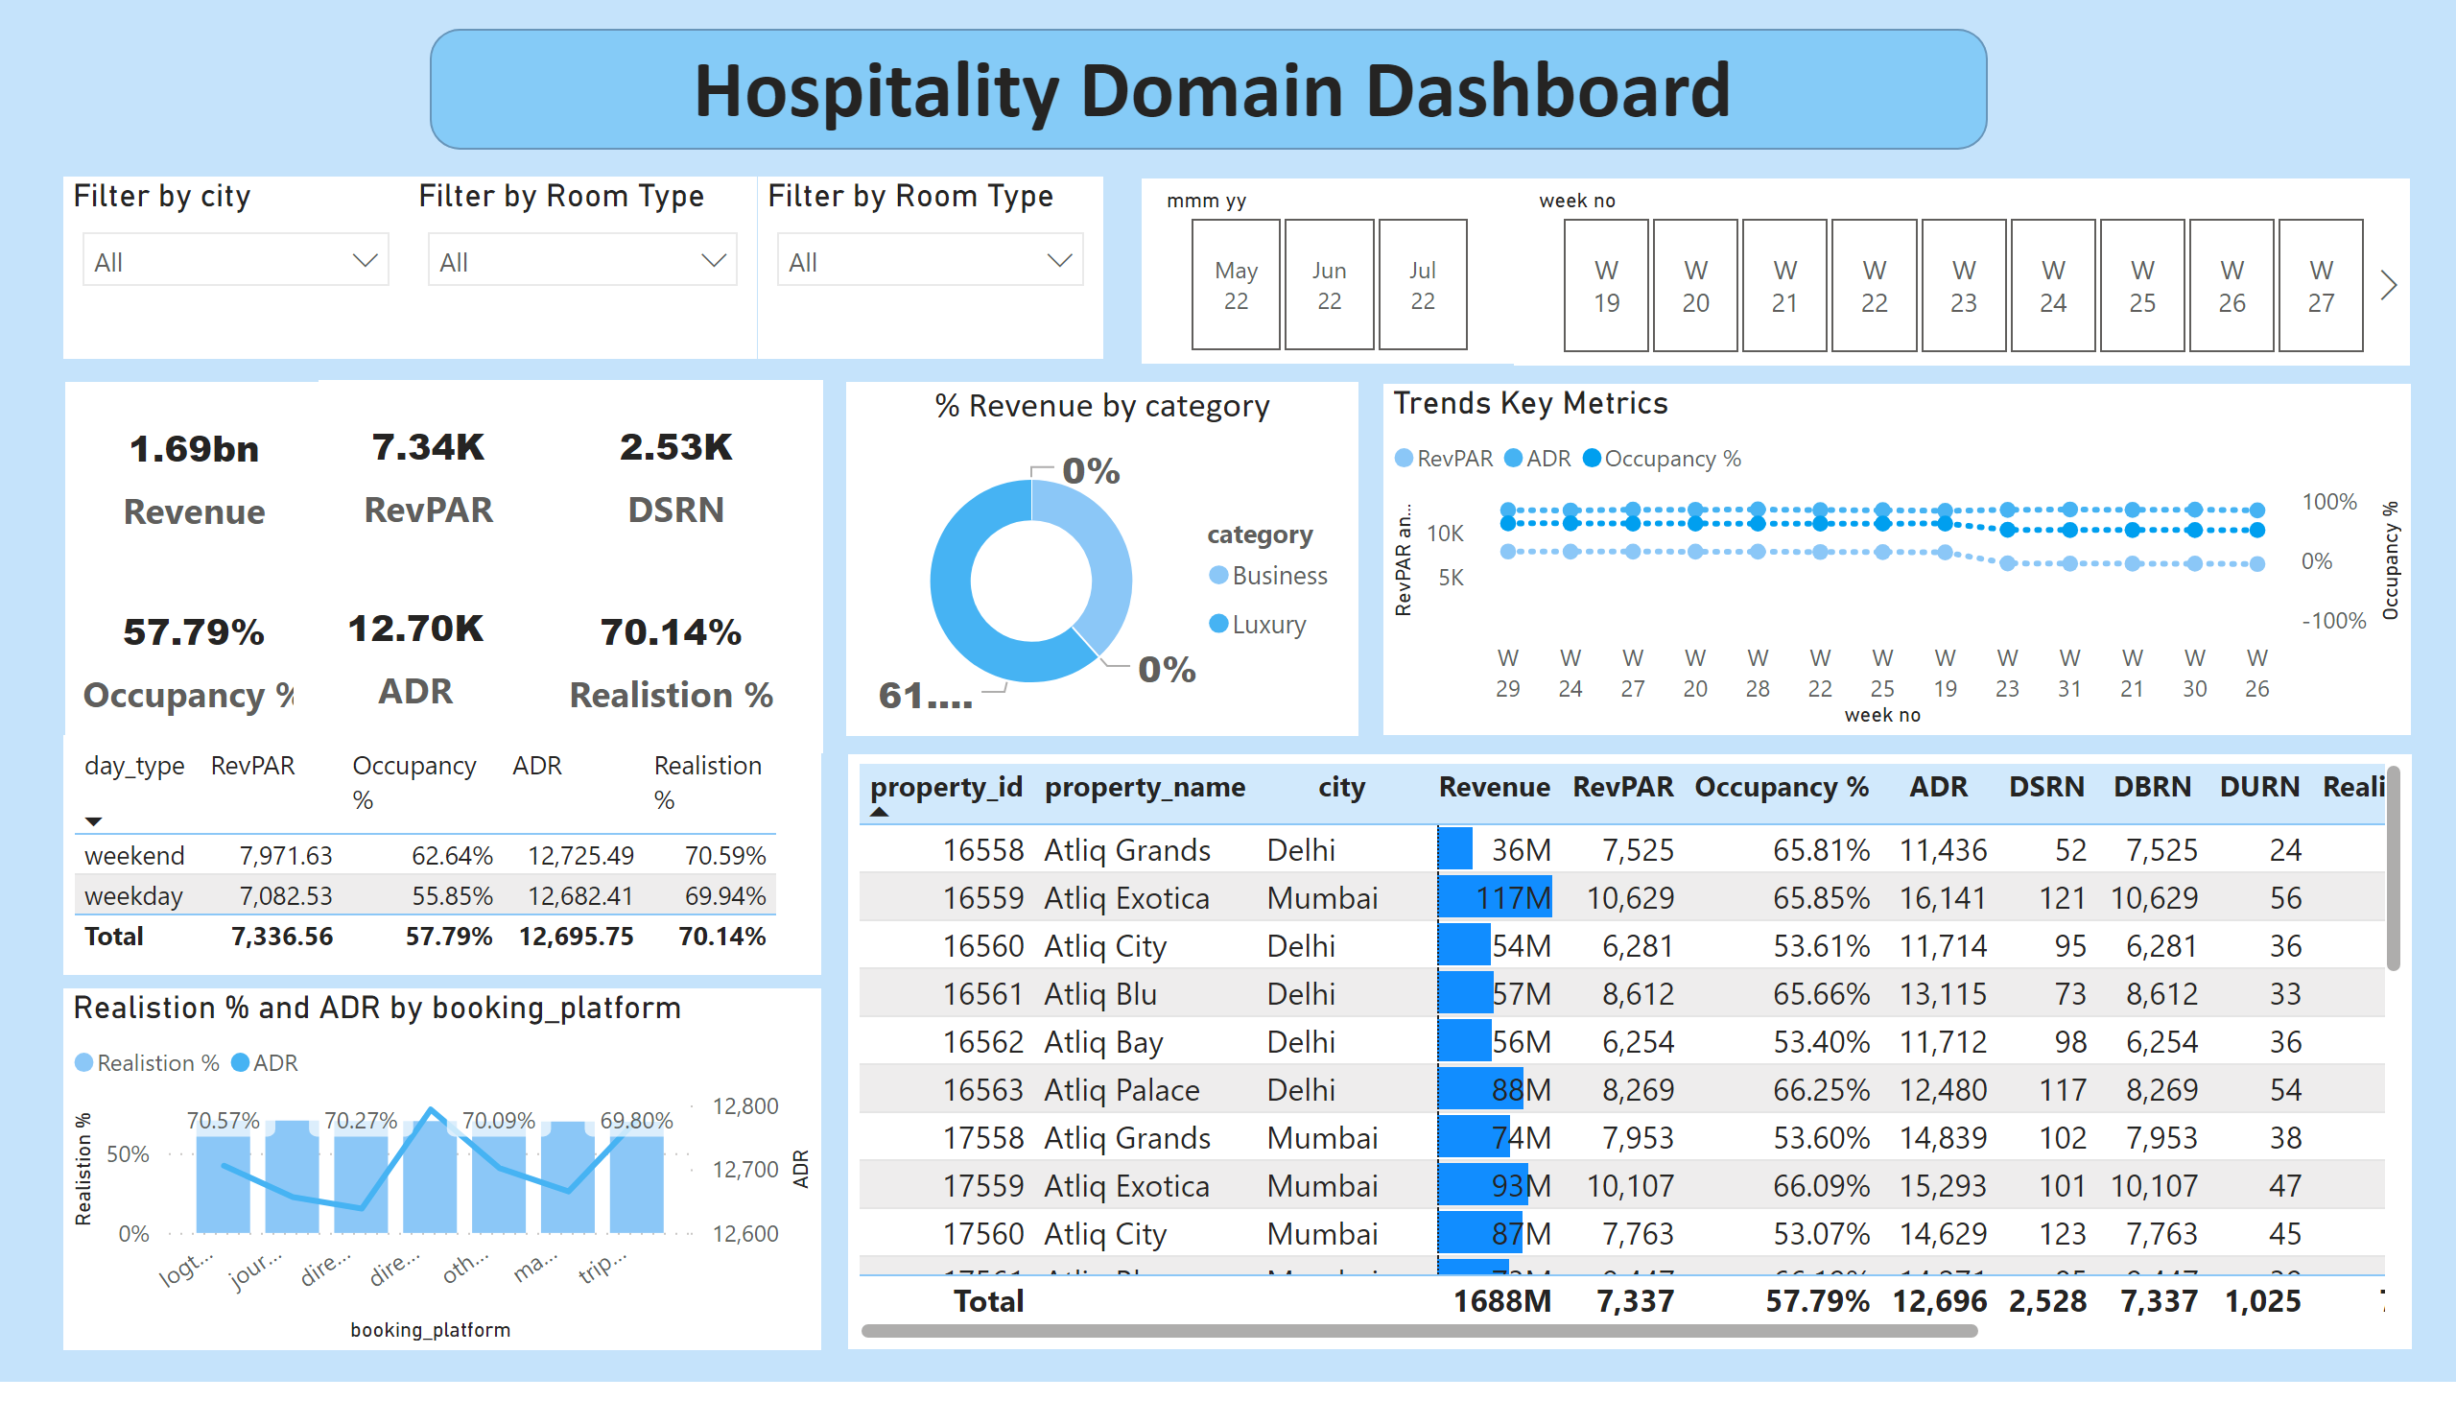
Main DashBoard
Notes:
tableEx
No alt text provided
Filter by city
No alt text provided
Filter by Room Type
No alt text provided
Filter by Room Type
No alt text provided
slicer
No alt text provided
slicer
No alt text provided
lineStackedColumnComboChart
No alt text provided
card
No alt text provided
card
No alt text provided
tableEx
No alt text provided
card
No alt text provided
card
No alt text provided
card
No alt text provided
card
No alt text provided
% Revenue by category
No alt text provided
Trends Key Metrics
No alt text provided
textbox
No alt text provided
shape
No alt text provided

Slide 3
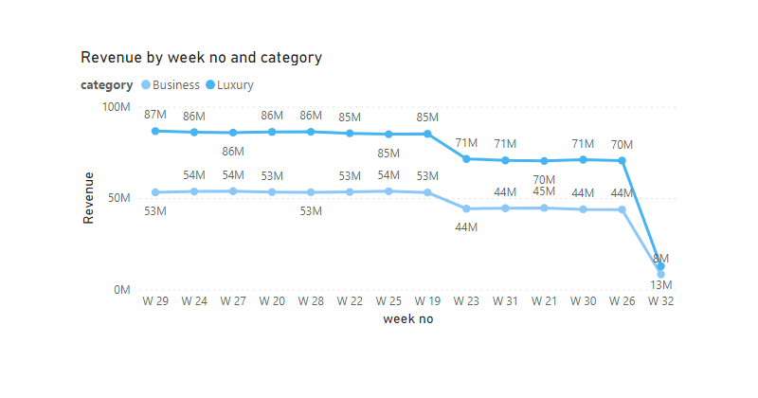
tool-tip revenue
Notes:
lineChart
No alt text provided

